Slide 1
Use Case Generalization

Slide 2
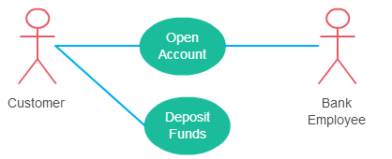
Association Between Actor and Use Case
An actor must be associated with at least one use case.
An actor can be associated with multiple use cases.
Multiple actors can be associated with a single use case

Slide 3
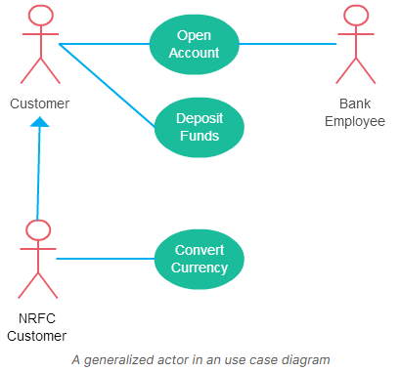
Generalization of an Actor
Generalization of an actor means that one actor can inherit the role of the other actor. The descendant inherits all the use cases of the ancestor. The descendant has one or more use cases that are specific to that role. Let’s expand the previous use case diagram to show the generalization of an actor.

Slide 4
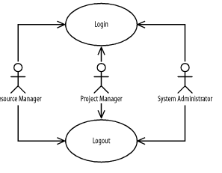
Generalization of an Actor
Figure shows that project managers, resource managers, and system administrators may log in and out of the project management system. Thus, logging in and out is common to these actors. Actor generalizations address such situations by factoring out and reusing similarities between actors

Slide 5
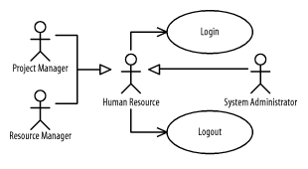
Generalization of an Actor
Use an actor generalization between actors when one actor is similar to another, but has specific interactions in which it participates or initiates. For example, any human resource may log in and out, but project managers, resources managers, and system administrators make more specialized use of the project management system. Because the Project Manager, Resource Manager, and System Administrator actors are specialized Human Resource actors, they benefit from the use cases in which the Human Resource actor is involved. Therefore, by developing the Login and Logout use cases, we provide the functionality described by those use cases for all the actors of our system.

Slide 6
Extend Relationship Between Two Use Cases
Many people confuse the extend relationship in use cases. As the name implies it extends the base use case and adds more functionality to the system. Here are a few things to consider when using the <<extend>> relationship.
The extending use case is dependent on the extended (base) use case. In the below diagram the “Calculate Bonus” use case doesn’t make much sense without the “Deposit Funds” use case.
The extending use case is usually optional and can be triggered conditionally. In the diagram, you can see that the extending use case is triggered only for deposits over 10,000 or when the age is over 55.
The extended (base) use case must be meaningful on its own. This means it should be independent and must not rely on the behavior of the extending use case.

Slide 7
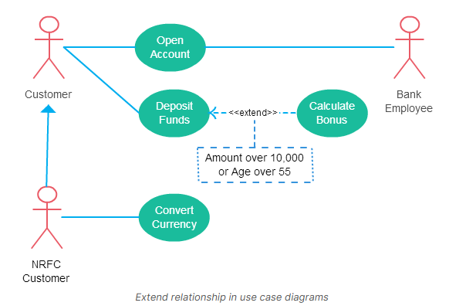
Extend Relationship Between Two Use Cases

Slide 8
Include Relationship Between Two Use Cases
Include relationship show that the behavior of the included use case is part of the including (base) use case. The main reason for this is to reuse common actions across multiple use cases. In some situations, this is done to simplify complex behaviors. Few things to consider when using the <<include>> relationship.
The base use case is incomplete without the included use case.
The included use case is mandatory and not optional.

Slide 9
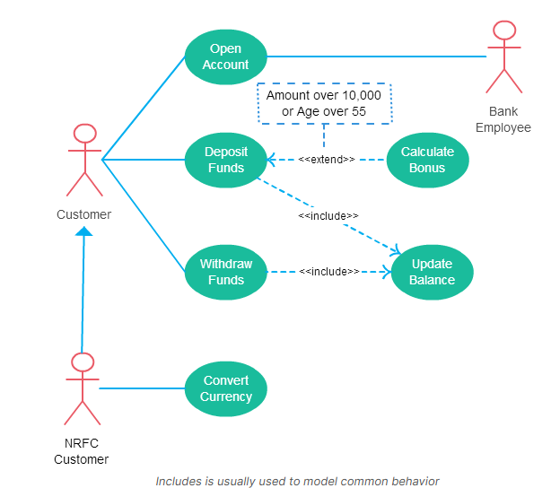
Include Relationship Between Two Use Cases

Slide 10
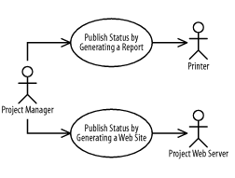
Use-Case Generalizations
Figure shows that a project manager may publish a project’s status in two ways: by generating a report to a printer or by generating a web site on a project web server. Thus, publishing a project’s status and all the processing involved in collecting and preparing the data for publication is common to these use cases. You can use a use-case generalization to address this situation by factoring out and reusing similar behavior from multiple use cases.

Slide 11
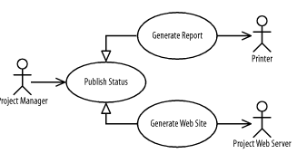
Use-Case Generalizations
You can use a use-case generalization between use cases when a more specific use case is similar to a more general use case but involves other actors or has specialized behavior. For example, a project manager may publish a project’s status using a report or a web site, but a printer is involved only if a report is generated, and a project web server is involved only if a web site is generated. Because the Generate Report and Generate Website use cases specialize the Publish Status use case, Publish Status must be developed before the other use cases; otherwise, the other use cases won’t have a use case to specialize.

Slide 12
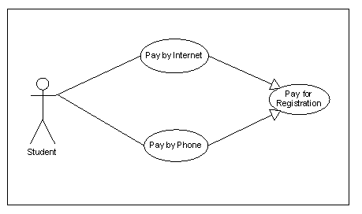
Possible but not liked method

